Slide 1
Project Scheduling
By Mohamed elrouby
Mohamed.elrouby.2014@uni.strath.ac.uk

Slide 2
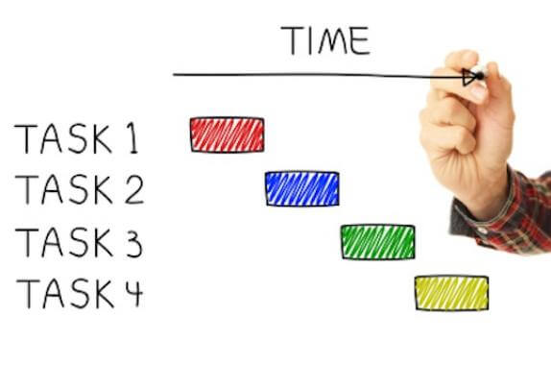
Project Scheduling
Define project scheduling
How to schedule a project
How to maintain project schedule once it started
Gantt Chart
Importance of project Scheduling
Conclusion

Slide 3
Definition
The project schedule is the tool that communicates what work needs to be performed, which resources of the organization will perform the work and the timeframes in which that work needs to be performed. The project schedule should reflect all of the work associated with delivering the project on time. Without a full and complete schedule, the project manager will be unable to communicate the complete effort, in terms of cost and resources, necessary to deliver the project. (Projectinsight.net, 2018)

Slide 4
how it started
In the past people printed a calendar on a shared wall room.
They used to have their project schedule shared using Spread sheets via email.
Now, managers use online project scheduling tools.
Project scheduling is usually a feature in a project management software where the managers can set a deadline for their teams.

Slide 5
Project Scheduling
Watch this video: https://www.youtube.com/watch?time_continue=124&v=U1Yqpeu9IBY

Slide 6
How to schedule a project
Project scheduling occurs during the planning phase.
You have to answer three questions:
What needs to be done?
When will it be done?
Who will do it?
Once figured the answers you can begin to plan dates, link activities, set the duration, milestones and resources.
Four Steps need to be followed for scheduling a project.

Slide 7
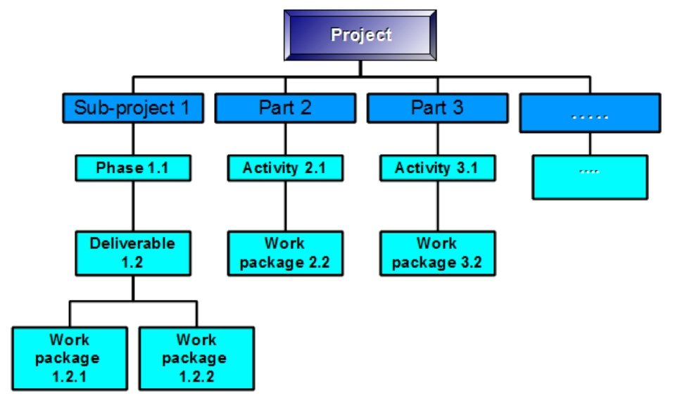
Step 1: define activities
You can use Work Breakdown Structure (WBS) to structure your project.
WBS is a chart where the project’s tasks are illustrated to reflect their relations to each other and to the project in general.
It helps with correct project organization.
(Kukhnavets, 2016)

Slide 8
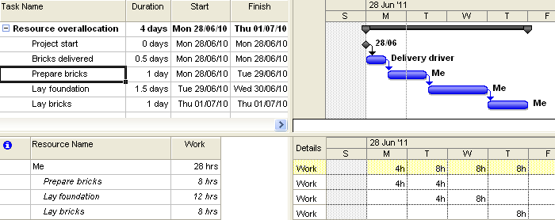
Step 2: do estimates
After defining activities within the project using WBS you can determine the time and effort it will take to finish these activities.
It is very important to calculate this piece of information correctly to estimate the correct deadline for each tasks.

Slide 9
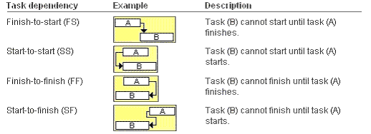
Step 3: Determine Dependencies
Tasks, especially in a big project, cannot be started until other is completed.
This is called Task Dependency.
By determining dependencies you will have a better understanding and judgement on deciding due date.

Slide 10
Step 4: assign resources
The last step to finalise the planned schedule is to decide on what resources the project is going to need to finish it on time.
Assembling a team that can finish their tasks in time.
The team will need to be scheduled just like the tasks to prevent any delays.

Slide 11

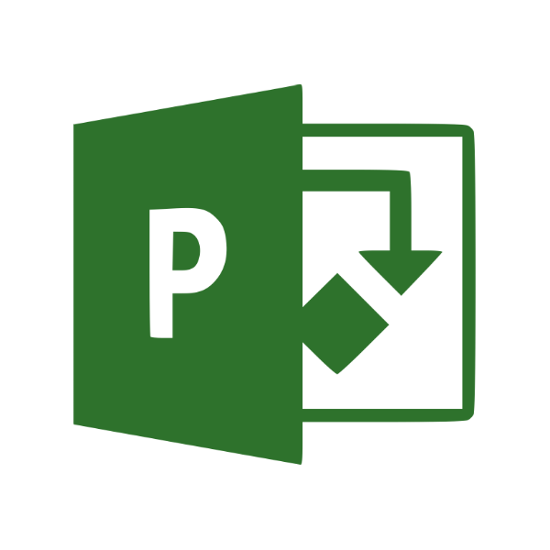

Maintaining project schedule once initiated
The last thing a project manager should do is scheduling the project manually using excel spreadsheet.
Project management software can automate most of the process.
Examples: Zoho Projects, Microsoft Project Online, Basecamp, Smartsheet and Asana.
There are three tiers of scheduling and project managers should pick the best project management software that can adapt to their projects.

Slide 12
Tier 1: Scheduling tasks
Project management software gives you the flexibility to handle the variety of responsibilities attached to each tasks in the project.
Using Gantt chart gives you a visual representation of each task’s duration and helps to change deadlines if needed and updates the whole Gantt chart.
Project management software has several automation processes which notify the project manager when someone finished their tasks and all the information is updated online.

Slide 13
Tier 2: scheduling people
Scheduling the team is as important as scheduling the tasks.
People are going to take off for holidays, personal days and vacation.
Using online software helps the project manager to identify the team member’s availability.
Keep track of the progress of each member of the team work on their tasks.

Slide 14

Tier 3: Scheduling projects
Project managers usually have more than one project and they need to schedule their projects.
Project managers can manage projects by checking on the progress of every project and adjust them if they need to be.

Slide 15
Project Scheduling Software
Reasons to use Project Scheduling Software:
Define the project workflow and keep the team focused on the right tasks.
Identify and track your project’s critical path to leverage flex in the schedule.
Waste less time rescheduling with priorities & dependencies that automatically adjust.
Set project baselines to track your project plan against your execution.
Free up time and energy by setting the tool to provide automatic deadline reminders.
Easily visualize, compare, spot holes and adjust your resource availability.
Generate reports on utilization, organizational demand and capacity.

Slide 16
Gantt chart
Watch this video: https://www.youtube.com/watch?v=VIm8yWpBxFA

Slide 17
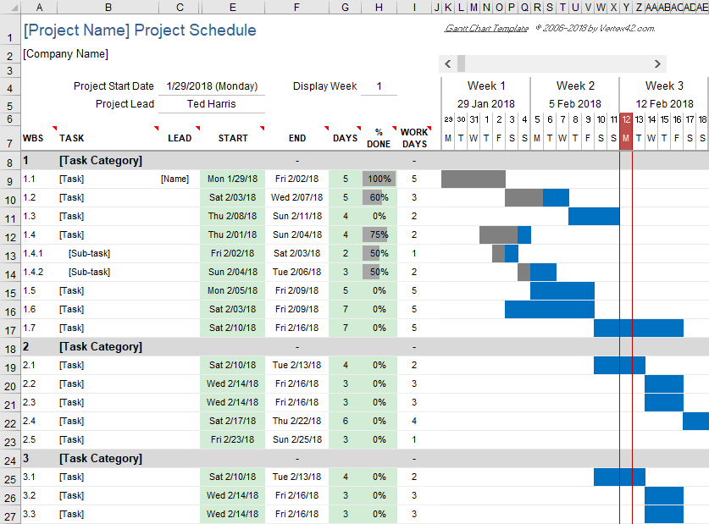
Gantt Chart
A Gantt chart, commonly used in project management, is one of the most popular and useful ways of showing activities (tasks or events) displayed against time. (Gantt.com, n.d.)
Gantt chart shows you what has to be done (the activities) and when (the schedule).

Slide 18
Importance of Project scheduling

Slide 19
References:
Ray, S. (2017). What Is Project Scheduling?. [Blog] Project manager. Available at: https://www.projectmanager.com/blog/what-is-project-scheduling [Accessed 11 Oct. 2018].
Projectinsight.net. (2018). Project Scheduling | Project Management Basics. [online] Available at: https://www.projectinsight.net/project-management-basics/project-management-schedule [Accessed 11 Oct. 2018].
Kukhnavets, P. (2016). How to Improve Productivity With a Work Breakdown Structure?. [image] Available at: https://blog.ganttpro.com/en/how-to-create-a-work-breakdown-structure-wbs-with-project-planning-templates/ [Accessed 11 Oct. 2018].
KnowledgeHut (2018). Project Scheduling with Critical Path Method. [video] Available at: https://www.youtube.com/watch?time_continue=124&v=U1Yqpeu9IBY [Accessed 5 Nov. 2018].
UMNwrittingstudies (2013). Project Management: What is a Gantt Chart?. [video] Available at: https://www.youtube.com/watch?v=VIm8yWpBxFA [Accessed 1 Nov. 2018].

